Slide 1
Notes:
Quick question – who here has tried yoga? Well, I also gave yoga a shot, since they introduced the hybrid setup where you can try to be healthy at home. And let me tell you.. I have absolutely no idea what I was doing. It's not like you’re in the studio with an instructor helping you what to do. You just try to match what the instructor is doing and hope you’re doing it right.
But guess what? We've got a game-changer to revolutionize the fitness and health community

Slide 2

With us you can have innovative facility in your everyday life
Mayuresh Nerurkar | Mae Lam | Ramuel John Batuigas | Wai Hong Fung | Megi Xhafka | Ho Kong Leung | Tasneem Pipalyawala
Notes:
Say hello to the Yoga Assessment AI System – where AI and computer vision are channeled to make our experiences better.

Slide 3
01
Problem
Significance
Literature Review
Methodology - ML Canvas
Model Benchmarking
Model Deployment
Demo
02
AGENDA
03
04
05
06
07

Slide 4
Lack of real-time guidance
01
PROBLEM
Limited access to expert instructors
02
Incorrect yoga poses lead to injuries and hinder progress
Hampered workout effectivity and safety concerns
03
Notes:
Studies show that injuries happen in about 6 out of every 1000 hours of yoga practice. For first timers, the risk is even higher. As we shift towards online practices, the lack of guidance to uphold proper form and technique as we have our experts online, which will decrease the effectivity of the workout and poses safety concerns

Slide 5
SOLUTION
An AI-powered web platform that captures, detects and assesses yoga poses
01
02
03
User friendly integration
Personalized guidance
Immediate feedback

Slide 6

Literature Review
MyFitnessPal
Objective: Integrate image recognition to identify food items and estimate calorie intake.
Outcome: Simplified food logging for users, increasing app engagement.
Learning: Visual tools can enhance user experience significantly.

Slide 7
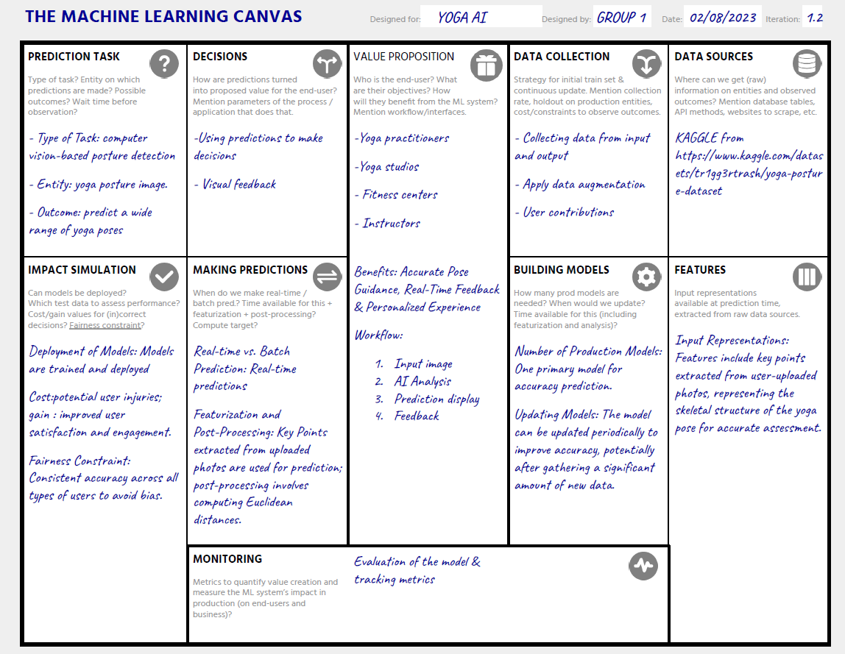


Slide 8
MODEL BENCHMARKING
SVM
K-Nearest Neighbors
Naive Bayes
AdaBoost
81%
78%
59%
40%
BEST MODEL
85%
Random Forest Classifier

Slide 9




MODEL DEPLOYMENT

Slide 10
Challenges & Issues encountered
Challenges:
Imbalanced classes
FIX: SMOTE
Alignment susceptible to accuracy:
FIX: Key distances
Issues:
Live Feed: Cloud deployment

Slide 11

THANK YOU
Open for Questions

